Slide 1


INF 154
PRACTICAL 2
2023

Slide 2
At the end this practical you should be able…
To work with additional controls such as Combo Boxes, Numeric up downs , Rich Textbox, List Boxes, Tab Controls & Radio buttons.
To work with variables and constants.
To do basic string manipulation.
To do basic arithmetic.

Slide 3

What are we going to do?
Prac 2a: Tab controls
Prac 2b: Basic String manipulation along with variables
Prac 2c: Basic Arithmetic along with constants
Prac 2d: Take Home Practical

Slide 4
Practical Exercise 2a
The practical will involve the basic concept of Tab Controls, and take a harder look into how you can add, remove and edit each tab in the TabControl control as well as edit the TabControl itself.
Create a windows forms project and add a TabControl with three tabs
Make sure each tab is named accordingly, using the standard naming conventions (i.e. tabOne, tabTwo….)
Each tab should contain Text values to allow the user to see which tab they are on (i.e. ‘Tab One’, ‘Tab Two’, ‘Tab Three’…..)
Add a button in each tab and name them accordingly, using the standard naming conventions (i.e. btnTabOne, btnTabTwo, btnThree….)
We are going to manipulate the text properties of the buttons, while simultaneously manipulating the appearance of the TabControl appearance.

Slide 5
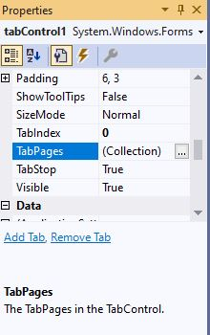
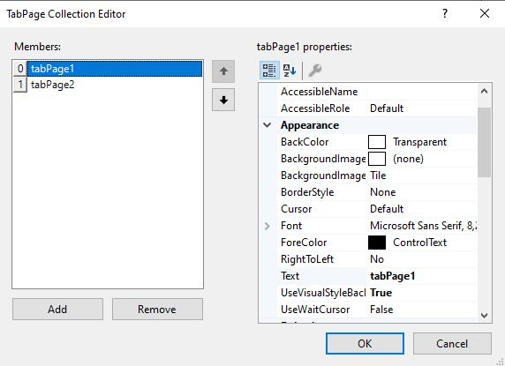
Practical Exercise 2a
Gain access to the tab page properties by first selecting the TabControl1 control. Secondly, find the TabPages property in TabControl1’s property window.
Click on the three dots (…) button and it will open a new window where you can add, remove and edit each tap page in the tabControl

Slide 6
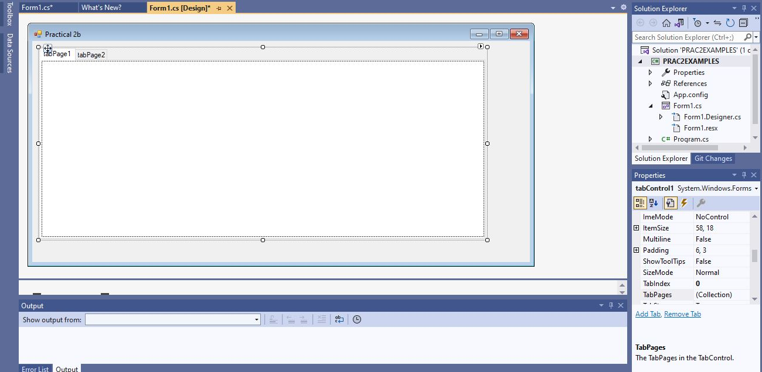
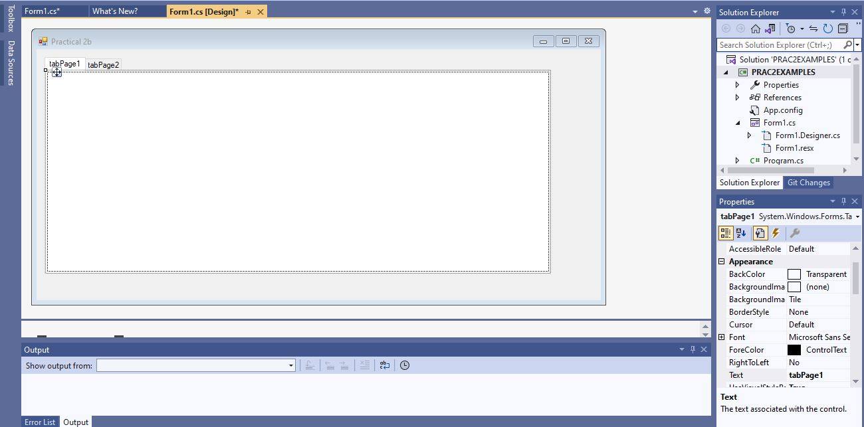
Practical Exercise 2a
Please understand the difference between the tabcontrol and it’s tab pages. This is the tab control selected
Click on the three dots (…) button and it will open a new window where you can add, remove and edit each tap page in the tabControl

Slide 7
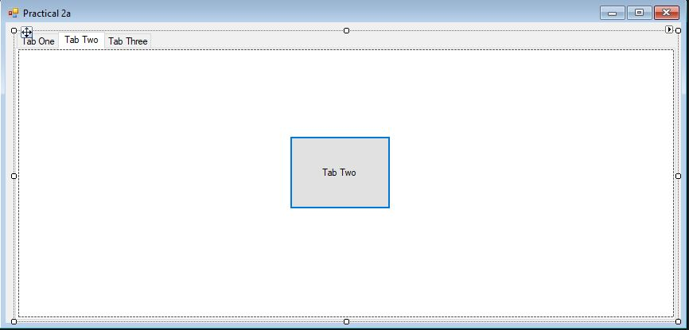
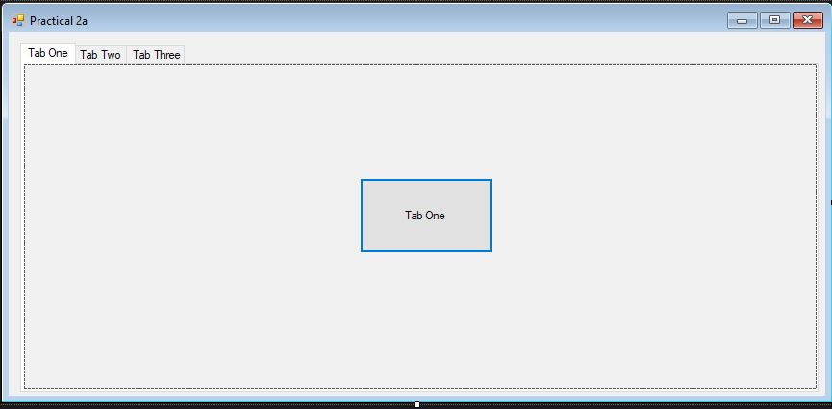
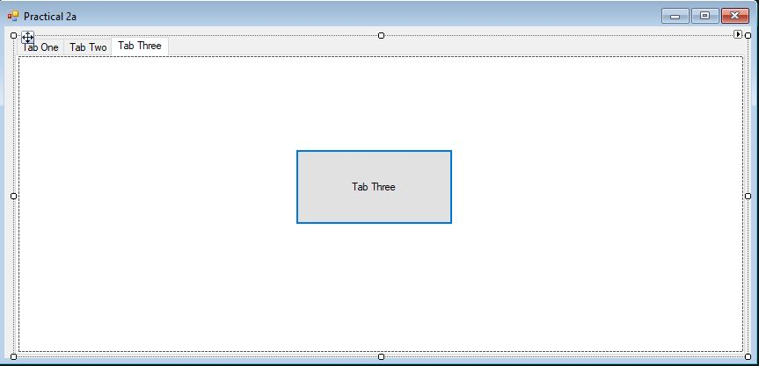
Practical Exercise 2a
The Expected Form Design
Tab Two
Tab One
Tab Three

Slide 8
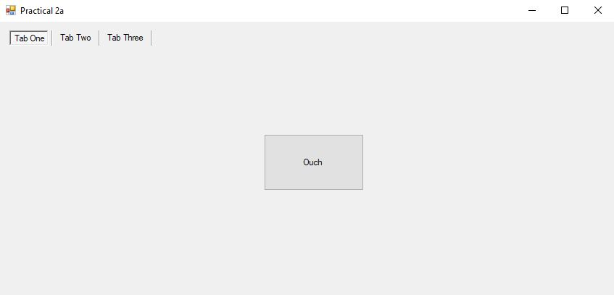
Practical Exercise 2a
After clicking btnTabOne, the TabControl appearance should change to the ‘FlatButtons’ appearance and the Text on btnTabOne should change from ‘Tab One’ to ‘Ouch’.
It should look as follows:

Slide 9
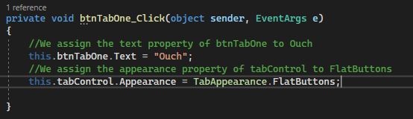
Practical Exercise 2a
How the code should look for tab one:

Slide 10
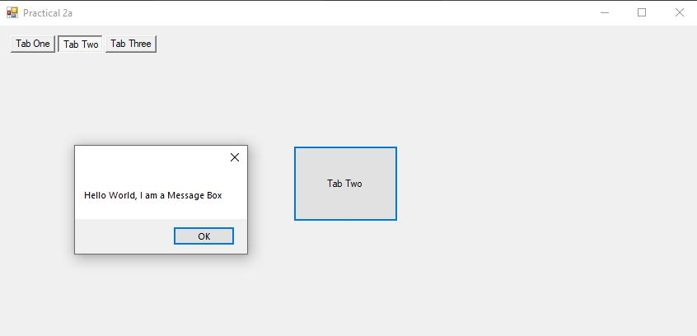
Practical Exercise 2a
After clicking btnTabTwo, the TabControl appearance should change to the ‘Buttons’ appearance and a MessageBox should display ‘Hello world, I am a Message Box.’
It should look as follows:

Slide 11
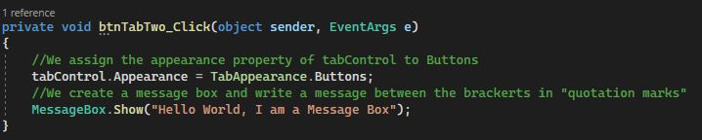
Practical Exercise 2a
How the code should look for tab two:

Slide 12
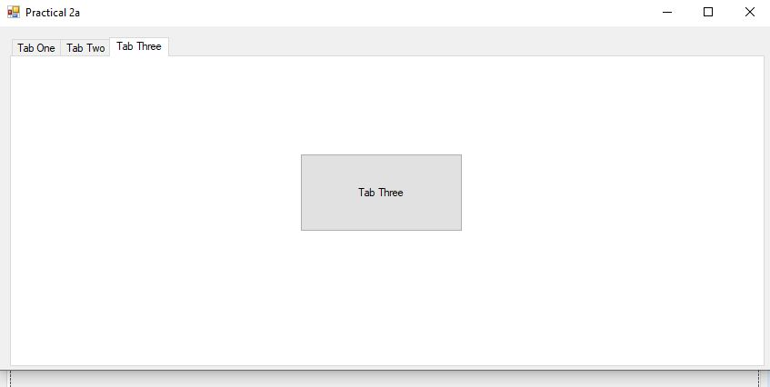
Practical Exercise 2a
After clicking btnTabThree, the TabControl appearance should change to the ‘Normal’ appearance.
It should look as follows:

Slide 13

Practical Exercise 2a
How the code should look for tab three:

Slide 14
Practical Exercise 2b
The practical will involve the basic concept of all programs, INPUT-PROCESSING-OUTPUT along with the introduction of variables.
Create a windows form program in which the user will be required to capture their personal details through windows forms controls (i.e. cbxTitle, txtName, txtSurname, txtAddress & nudAge).
The Capture button will be responsible for handling the user inputs (Name, Address, Title etc.), processing it into one combined string and outputting it on the richtextbox.
The Clear button will be responsible for clearing the text on all the windows form controls.

Slide 15
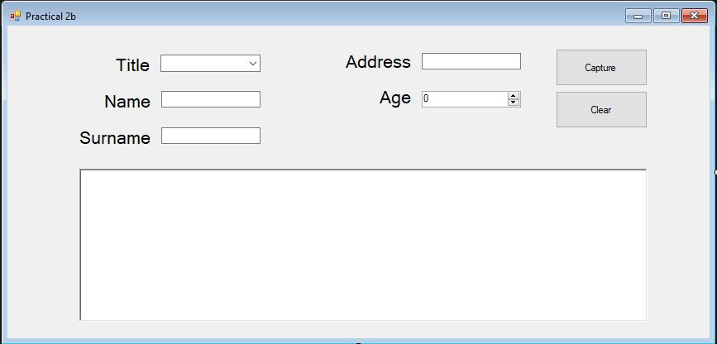
Property name:
cbxTitle (Combo Box)
txtName
txtSurname
txtAddress
nudAge (Numeric Up Down)
Practical Exercise 2b
Property name:
btnCapture
Text name:
Capture
The Expected form design
Property name:
btnClear
Text name:
Clear
Property name:
rtbOutput (RichTextBox)

Slide 16
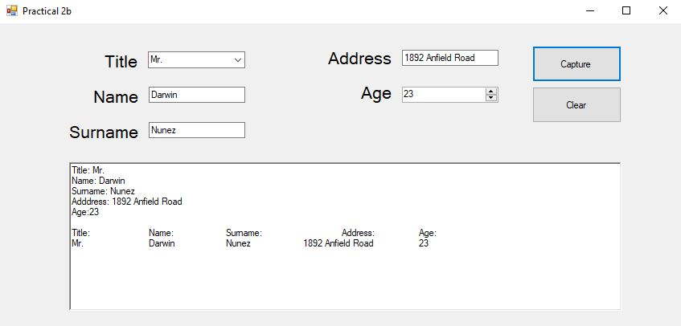
Practical Exercise 2b
The Expected Functionality when the Capture button is clicked. The user’s details will be added in the richtextbox (rtbOutput) and formatted as follows.

Slide 17
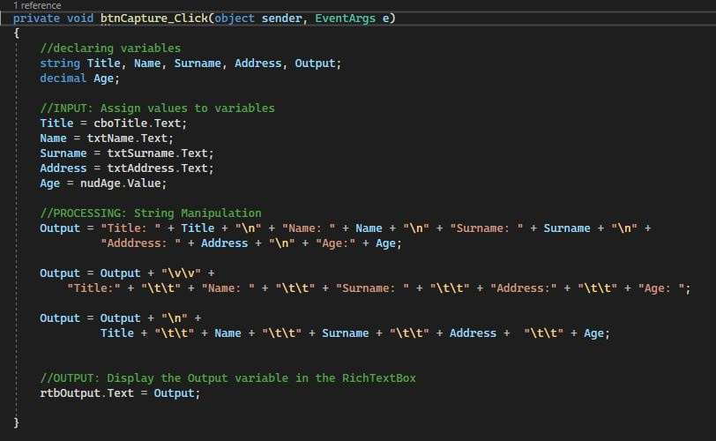
Practical Exercise 2b
The Expected Code for btnCapture

Slide 18
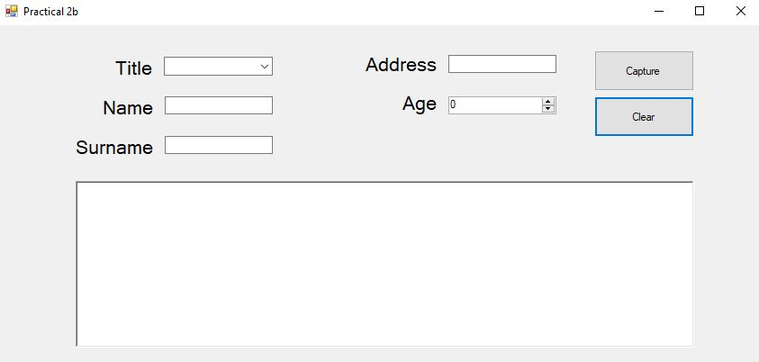
Practical Exercise 2b
The Expected Functionality when the Clear button is clicked. The user’s details and richtextbox information will be cleared.

Slide 19
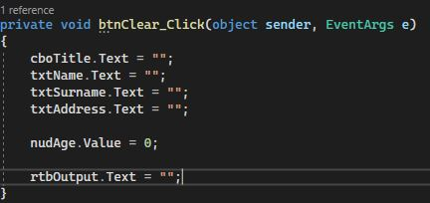
Practical Exercise 2b
The Expected Code for btnClear

Slide 20
Practical Exercise 2c
This practical exercise is another example that will involve the basic concept of INPUT-PROCESSING-OUTPUT along with the introduction of constants.
Create a windows form program in which the user will be able to input a radius of a circle using a textbox control (txtRadius).
The Circumference radio button will be responsible for calculating the circumference of a circle and displaying it using a MessageBox.
The Area radio button will be responsible for calculating the area of a circle and displaying it using a MessageBox.

Slide 21
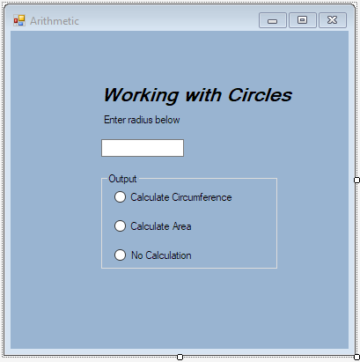
Practical Exercise 2c
Property name:
txtRadius
Text name:
Radius
The Expected form design
Property name:
radCircumference
Text name:
Circumference
Property name:
radArea
Text name:
Area
Property name:
radNone
Text name:
None

Slide 22
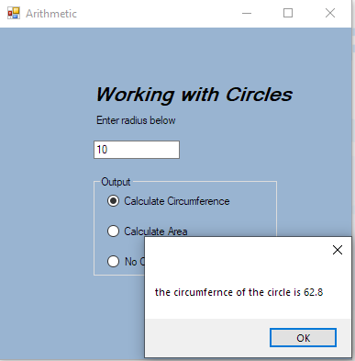
Practical Exercise 2c
The Expected Functionality when the Circumference radio button is clicked. The circumference of the circle will be displayed as shown below.

Slide 23
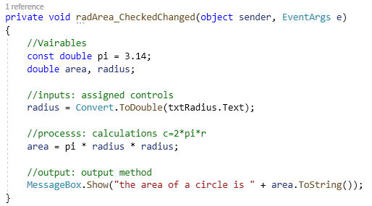
Practical Exercise 2c
The Expected Code for radArea

Slide 24
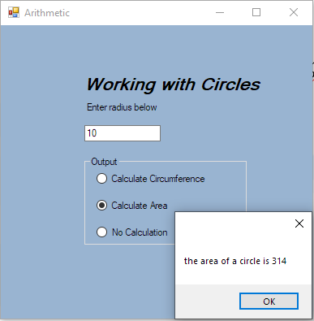
Practical Exercise 2c
The Expected Functionality when the Area radio button is clicked. The area of the circle will be displayed as shown below.

Slide 25
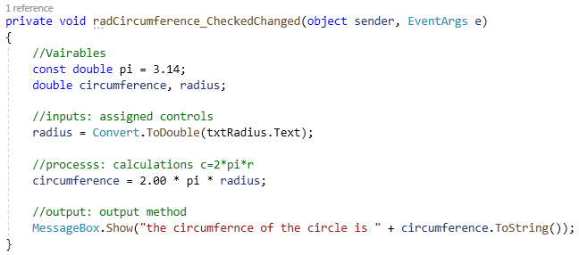
Practical Exercise 2c
The Expected Code for btnCircumference

Slide 26
Additional information
1. Create Windows Form Projects
2. Add Required Controls
3. Change Control Properties e.g. Text & Name
4. Add Required Events to Desired Controls
5. Decide and Declare Variables
6. Add Algorithms / Statement code
7. Run Windows Form Projects

Slide 27
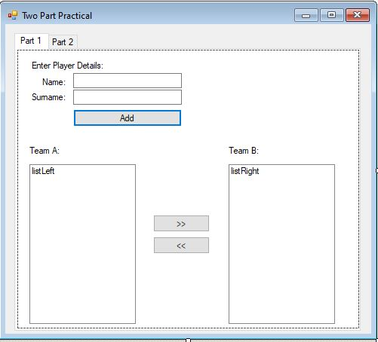
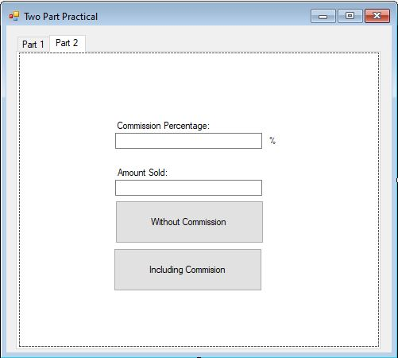
Practical Exercise 2d (TAKE HOME ASSESSMENT)
Try this yourself
You are expected to design the following windows form.
Hint: tabcontrol maybe used to display several controls in each separate tab page within the same windows form.

Slide 28
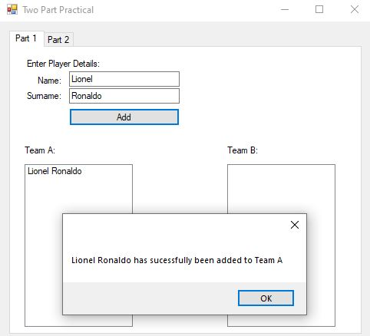
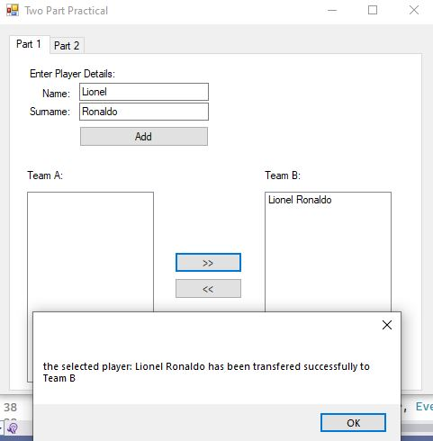
Practical Exercise 2d (TAKE HOME ASSESSMENT)
Part 1:
When the Add button is clicked, this section of the application captures a new player registered and adds them to the list box on the left. A message box should appear indicating that the player has been added. The player is transferred from one team (listbox) to the other team (listbox) by first selecting them from the list box on the left side and clicking the >> button. This procedure can also be done in reverse. Use a messagebox to indicate that the transfer has happened (show which player and to which team)
Tip: Google how to add and remove items from a list, as well as how to select a particular item in a list (Click the player you want to transfer before clicking the >> or << buttons)
When the add button is clicked.
After the transfer right >> button is clicked

Slide 29
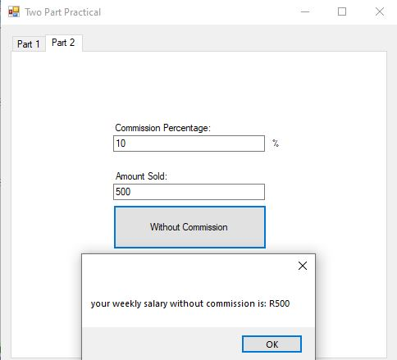
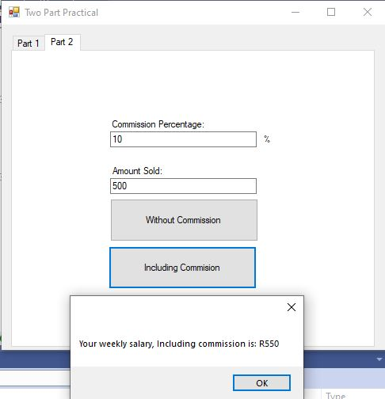
Practical Exercise 2d (TAKE HOME ASSESSMENT)
Part 2:
In this part of the program, the user enters a commission percentage value (e.g 9%) as well as a total amount value that they managed to sell.
Your job is to create a program that will calculate their weekly salary which will include their commission earned on top of their fixed R500 weekly salary.
(For Example, Let’s say they managed to sell R100 worth of products and the commission rate is 10%, they should be getting a total weekly salary of R510)
Display these answers via a message box!
Tip: use constants for their fixed weekly salary
When the without commission button is clicked.
When the including commission button is clicked.

Slide 30
Questions?

Slide 31
Practical 2 Submission DETAILS
Submit your Practical 2 c project on ClickUP as Follows:
Due Date: Monday, 13 March 2022 by 08:30
Upload your visual studio solution under the Tab titled “Assessments tab -> 2023 Practical HW Submission” and use the Practical 2 Submission Link

